Slide 1
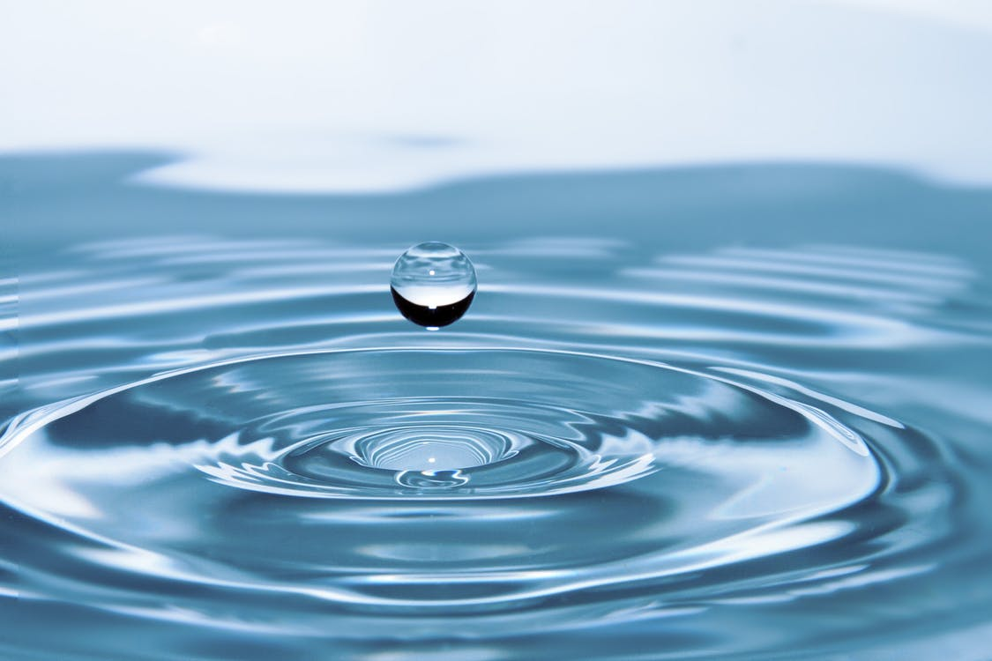
WATER CYCLE
We will explain the water cycle using states of matter.
Notes:
Insert cover image and use transparency settings to fade image.

Slide 2
Do not delete this slide.
This slide is designed so that you can copy the prompt box you need and insert it into your slides.
This slide is hidden and will not be included when presenting your lesson.
TRACK WITH ME
VOCABULARY
1 -
HINT
Students, remember….
CHECK FOR UNDERSTANDING
READ WITH ME
TEACHER CUE
MAKE THE CONNECTION
Students, you already know….
EXTENSION
GESTURE WITH ME

Slide 3
Match the term to its definition
Term | Definition
Moral factors | Whether the energy source is suited to the area.
2. Economic factors | B. Whether the energy source feels right to use.
3. Cultural factors | C. Whether the energy source will be good for the economy.

Slide 4
Repeat the opposite word/phrase.
RENEWABLE RESOURCE
IT WILL NOT RUN OUT

Slide 5
Repeat the opposite word/phrase.
NON-RENEWABLE RESOURCE
IT WILL RUN OUT

Slide 6
Repeat the opposite word/phrase.
TIMESCALE
TIME NEEDED TO COMPLETE A PROCESS

Slide 7
Repeat the opposite word/phrase.
SOLAR POWER
ENERGY FROM THE SUN

Slide 8
Repeat the opposite word/phrase.
HYDRO POWER
ENERGY FROM WATER

Slide 9
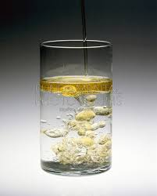
Is this a solution or a suspension?

Slide 10
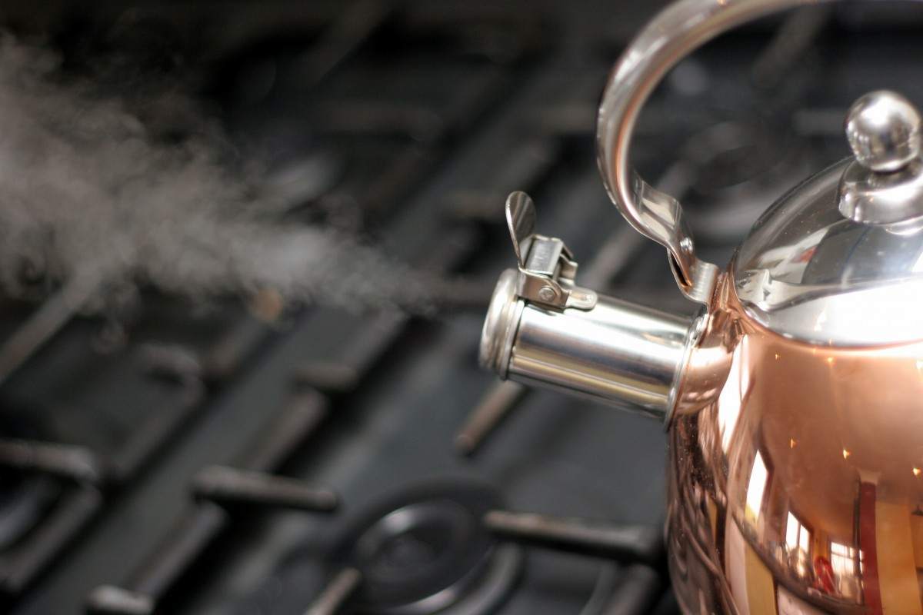
Using Whiteboards write solid, liquid or gas?
Steam from a kettle
Solid , liquid or gas?
HINT
Students, remember: Water exists in 3 different states, solid, liquid and gas

Slide 11
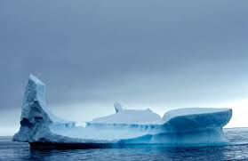
Iceberg in Antarctica
Solid, liquid or gas?

Slide 12
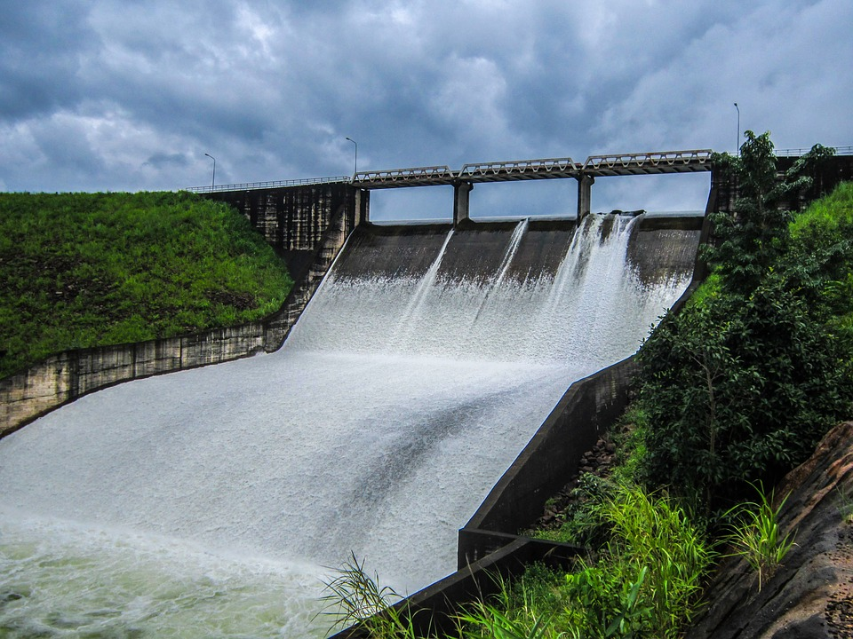
Water in a dam
Solid, liquid or gas?

Slide 13
We will explain the water cycle using states of matter.
TRACK WITH ME
READ WITH ME
We will describe water changing states.
We will explain the five main stages of the water cycle.
DECLARE THE OBJECTIVE
Read the learning objective to your partner.
Notes:
Learning Objectives contain concepts (nouns, big ideas), skills (verbs, measurable behaviours) and sometimes context (restricting or targeting conditions).
●Example: Students will be able to describe the concept of density and apply it to floating and sinking.
●
Success criteria are specific measurable outcomes that if met mean that the student has met the learning objective.
Examples:
•Students will be able to compare densities of substances using mass and volume.
•Students will be able to identify whether a solid or liquid will float or sink in a liquid based on their densities.

Slide 14
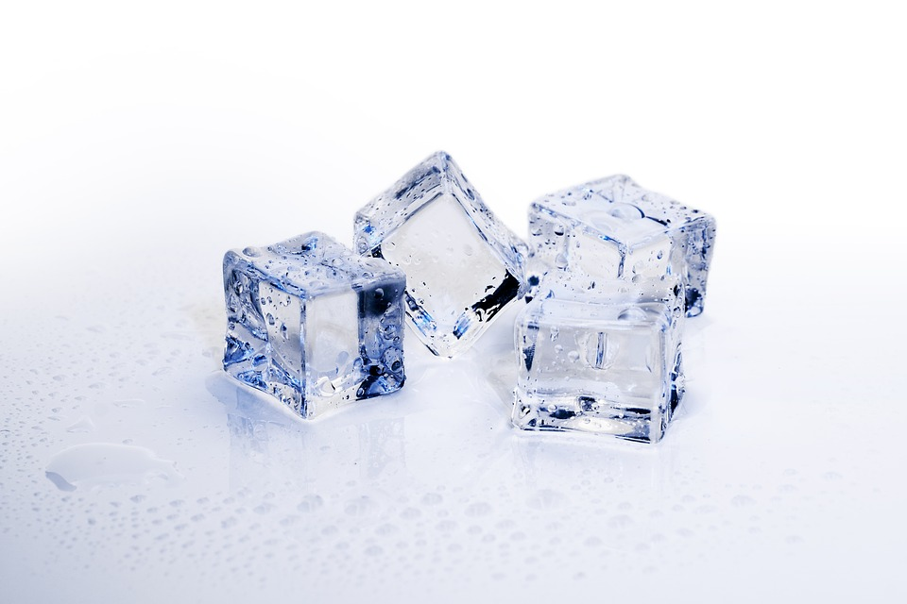
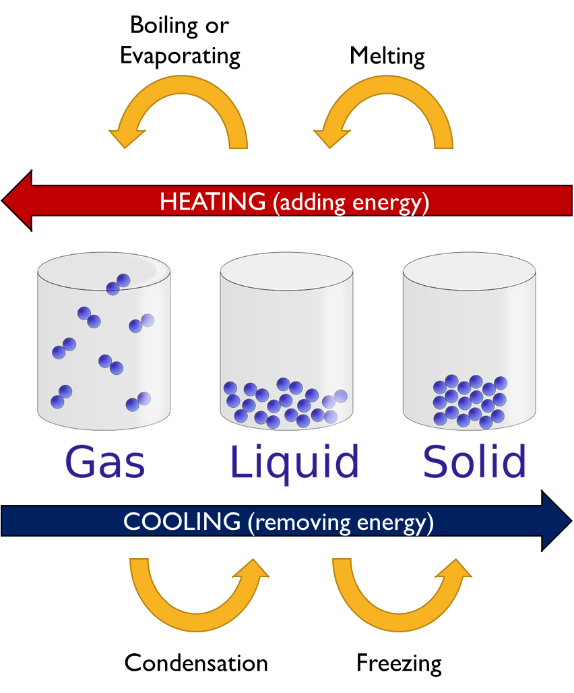
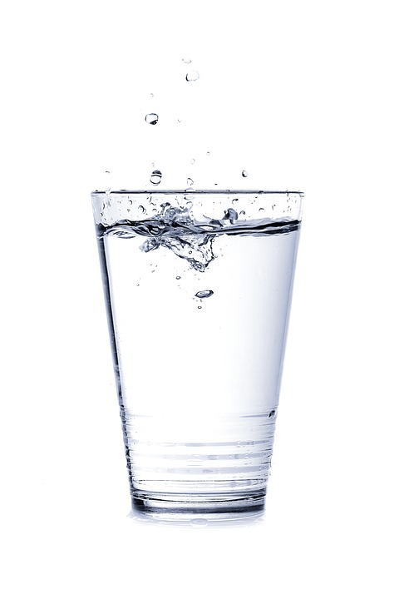
We will explain the water cycle using states of matter
MAKE THE CONNECTION
Students, you already know that there are three states of matter: solid, liquid and gas.
Water is a substance that exists in three different states, solid, liquid and gas. The state of matter can change when heat is added or removed.
Identify the state of matter for each type of water in the table below:
State | Example
Solid | Ice
Liquid | Water
Gas | Water vapour/steam
Type of water | State of matter (solid, liquid, gas)
Snow
Rain
Water Vapour
Hail

Slide 15
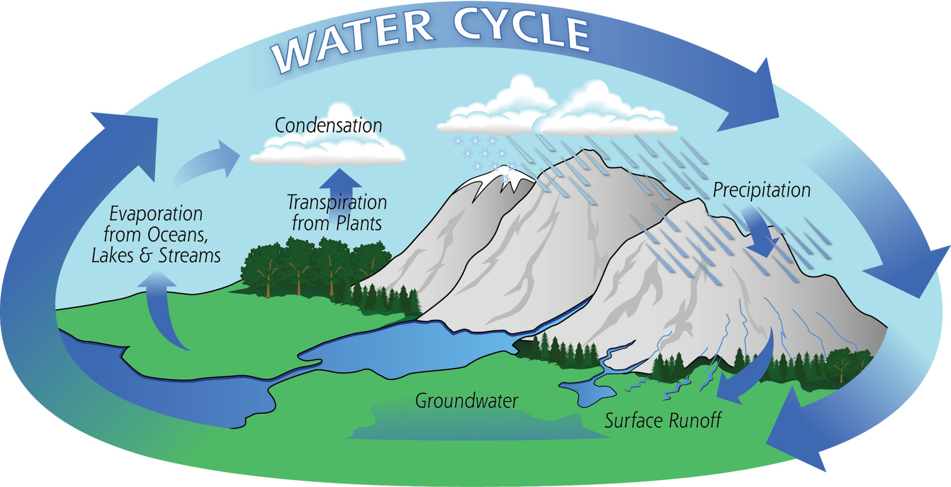
We will explain the water cycle using states of matter
Water is one of the most important resources on Earth. Water is constantly being recycled, this process is called the water cycle.
Water constantly changes its state of matter because of environmental changes. There are five main stages of the water cycle.
Evaporation
Transpiration
Condensation
Precipitation
Collection
CHECK FOR UNDERSTANDING
Why is water constantly being recycled?

Slide 16
We will explain the water cycle using states of matter
CHECK FOR UNDERSTANDING
Why does water from oceans, lakes and river evaporate?
Evaporation
Water from oceans, lakes and rivers turns into gas in the form of water vapour.
Transpiration
Plants lose water through the leaves.
VOCABULARY

Slide 17
We will explain the water cycle using states of matter
CHECK FOR UNDERSTANDING
Why does water vapour turn to water droplets in the sky?
Condensation
Water vapour turns into water droplets when it reaches the cold air in the sky, and the water droplets then form clouds.
VOCABULARY

Slide 18
We will explain the water cycle using states of matter
CHECK FOR UNDERSTANDING
Why can water fall to Earth as rain, snow or hail?
Precipitation
Clouds get too heavy from condensed water vapour, it falls back on Earth in the form of liquid rain or snow in colder parts or hail.
VOCABULARY

Slide 19
We will explain the water cycle using states of matter
Collection
Two things happen when liquid rain falls to the ground, some water goes through to the ground water table and some runoff to rivers and eventually into lakes and oceans.
VOCABULARY

Slide 20
We will explain the water cycle using states of matter
Stage | Process | State of Matter
Evaporation | Water from oceans, lakes and rivers turns into gas in the form of water vapour. | Gas
Transpiration | Plants lose water through the leaves. | Gas
Condensation | Water vapour turns into water droplets when it reaches the cold air in the sky, and the water droplets then form clouds. | Liquid
Precipitation | Clouds get too heavy from condensed water vapours, it falls back on earth in the form of liquid rain or snow in colder parts or hail. | Liquid or Solid
Collection | Two things happen when liquid rain falls to the ground, some water goes through to the ground and some runoff to rivers and eventually lakes and oceans. | Liquid

Slide 21
We will explain the water cycle using states of matter.
For each point below, identify the stage of the water cycle and what state of matter the water is in at this stage.
Water from oceans, lakes and rivers turns into gas in the form of water vapour.
Water vapour turns into water droplets when it reaches the cold air in the sky, and the water droplets then form clouds.
Clouds get too heavy from condensed water vapour, it falls back on earth in the form of liquid rain or snow in colder parts or hail.
TEACHER CUE
Complete first point as a class.

Slide 22
We will explain the water cycle using states of matter.
Water is one of the most important resources on Earth. Water is present in the atmosphere, on the surface of the land and underground.
70 % of Earth’s surface is covered by water.
Almost 97.5 % is found in the ocean and salt lakes, 2.5 % as ice and underground water and only 0.01% as renewable fresh water.
CHECK FOR UNDERSTANDING
Why is it important to replant trees after we chop them down?
VOCABULARY

Slide 23
We will explain the water cycle using states of matter.
Water exists in three different states: solid (snow or hail),liquid (rain) and gas (water vapour).
When heat is added or removed, water can change between the three states.
Water is constantly being recycled, this process is called the water cycle. The five main stages of the water cycle are:
Evaporation, Transpiration, Condensation, Precipitation, Collection
CHECK FOR UNDERSTANDING
How does water change between states of matter?

Slide 24
We will explain the water cycle using states of matter.
Answer the following questions in your workbook in full sentences.
HINT
Students, remember there are five stages if the water cycle. Evaporation Transpiration Condensation Precipitation Collection
Draw a diagram of the water cycle.
What causes evaporation and transpiration?
Why does water vapour turn to water droplets in the sky?
What would happen to the land if all plants and grass were removed from Whiteman park?
Notes:
Please include tasks/questions here rather than just referring to a worksheet. This will save on photocopying and facilitate sharing with other schools.
Try and build tasks/questions which escalate through Bloom’s Taxonomy. This will help with differentiation.

Slide 25
We will explain the water cycle using states of matter.
We will describe water changing states.
We will explain the five main stages of the water cycle.
CHECK FOR UNDERSTANDING
Check Success Criteria.

